Slide 1
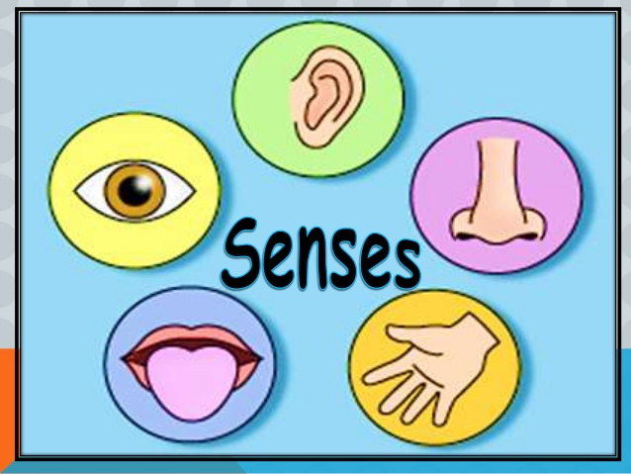
Chapter Two: Sensation & Perceptions

Slide 2
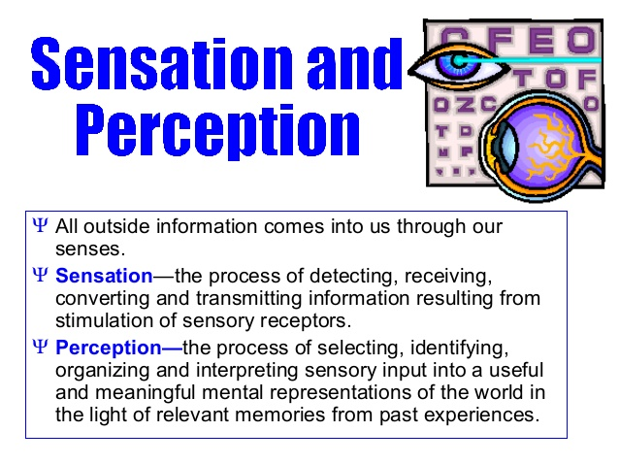
Chapter two :sensation and Perception

Slide 3
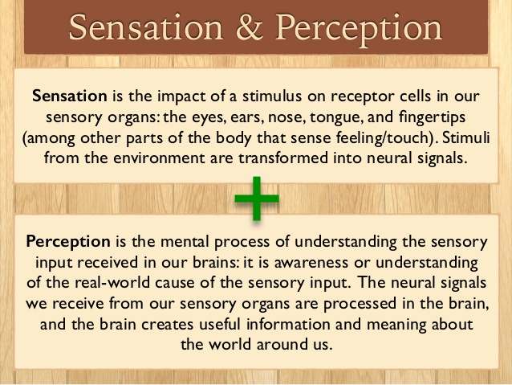
Chapter two :sensation and Perception

Slide 4
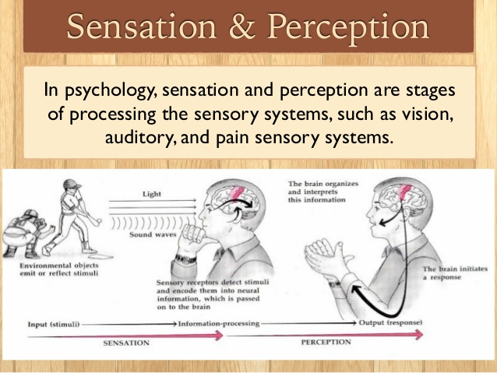
Chapter two :sensation and Perception

Slide 5
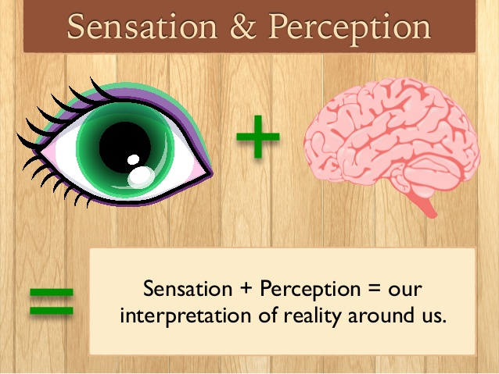
Chapter two :sensation and Perception

Slide 6
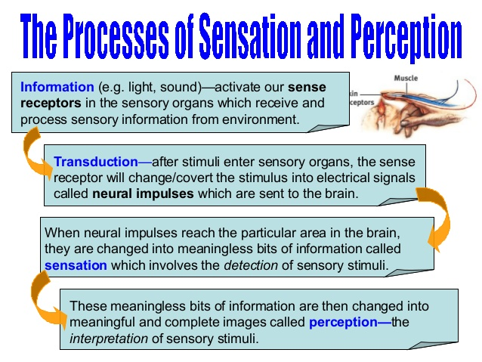
Chapter two :sensation and Perception

Slide 7
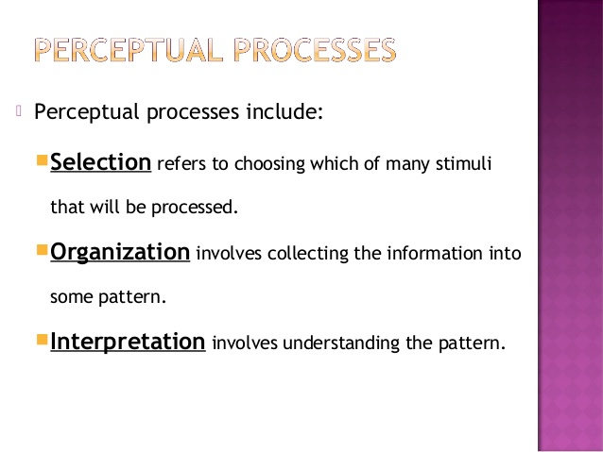
Chapter two :sensation and Perception

Slide 8
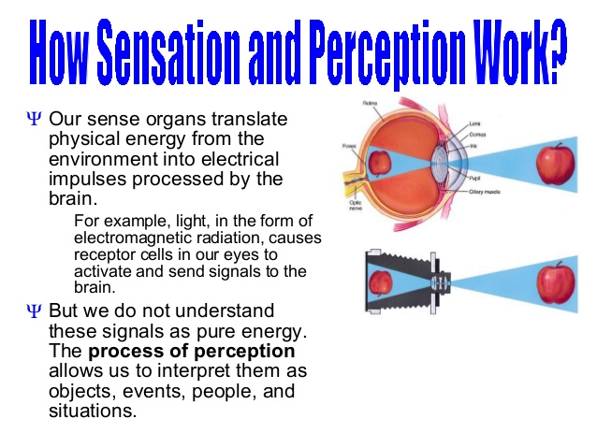
Chapter two :sensation and Perception

Slide 9
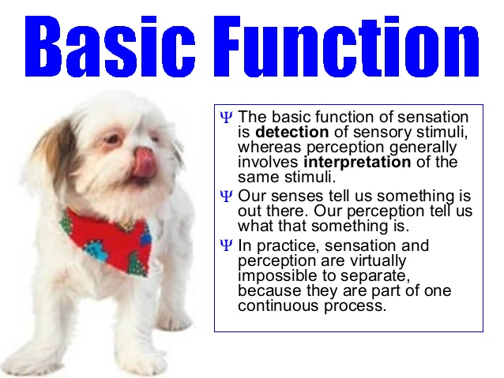
Chapter two :sensation and Perception

Slide 10
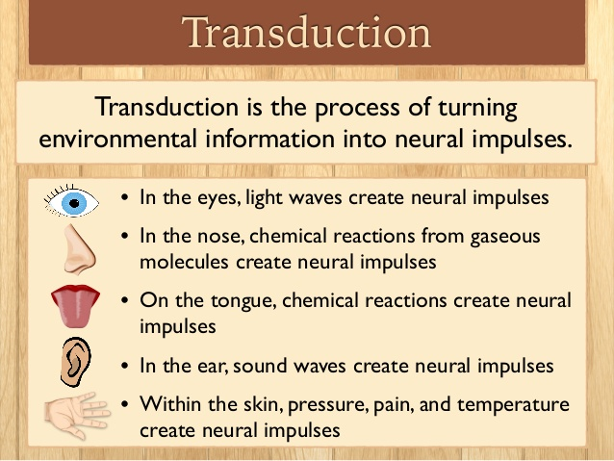
Chapter two :sensation and Perception

Slide 11
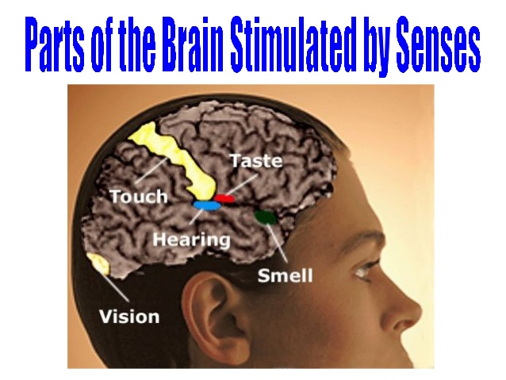
Chapter two :sensation and Perception

Slide 12

Chapter Two: sensation and Perception Sensory

Slide 13
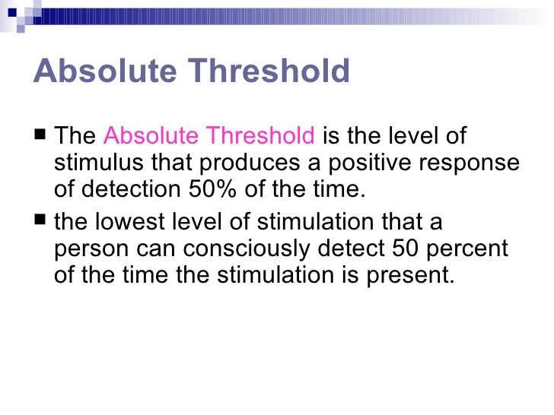
Chapter Two: sensation and Perception

Slide 14
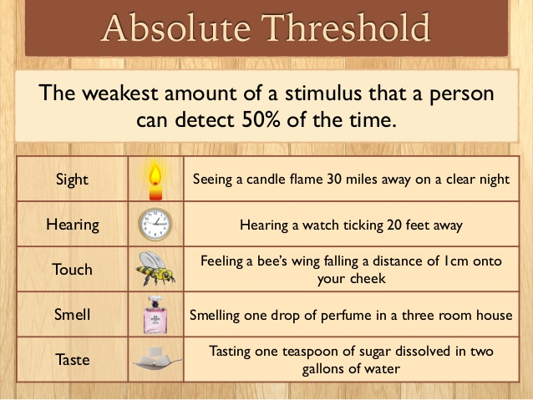
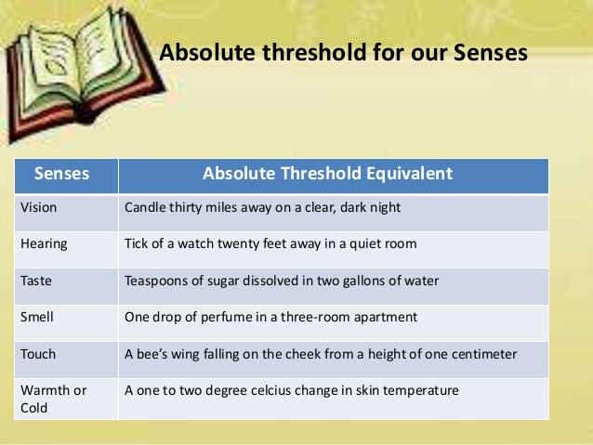
Chapter two :sensation and Perception

Slide 15
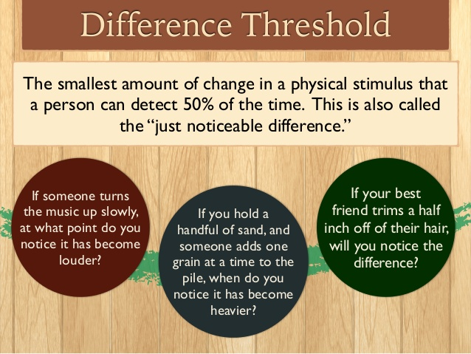
Chapter two :sensation and Perception

Slide 16
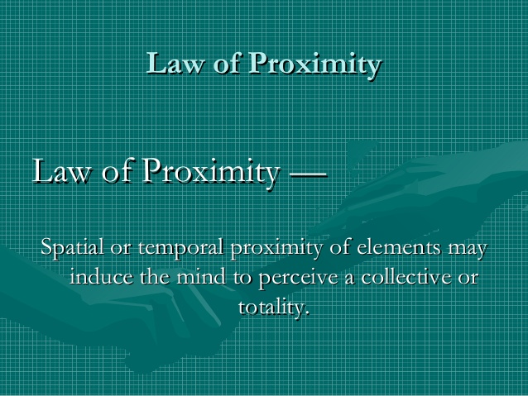
Chapter Two :laws of principles of perception

Slide 17
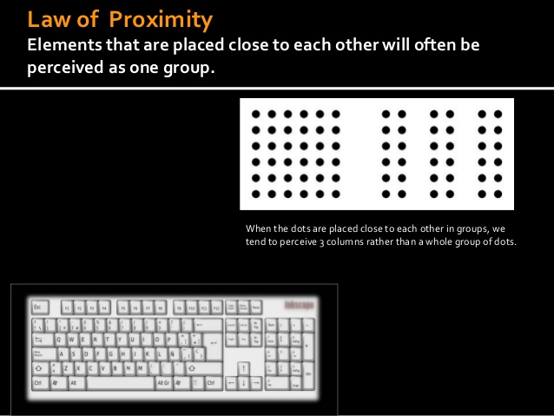
Chapter Two : laws of perception

Slide 18
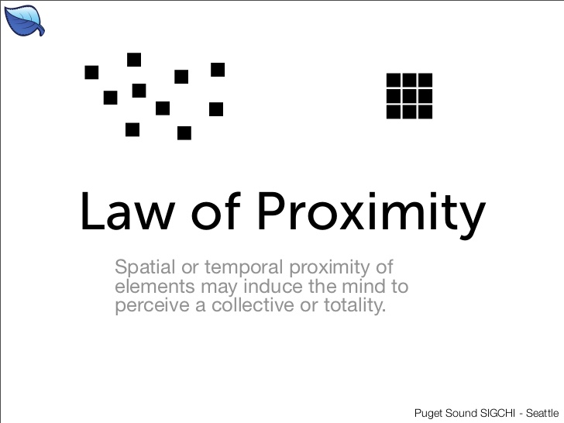
Chapter Two : laws of perception

Slide 19
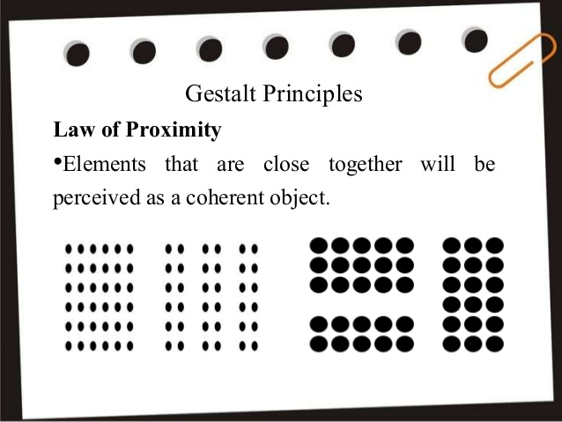
Chapter Two : laws of perception

Slide 20
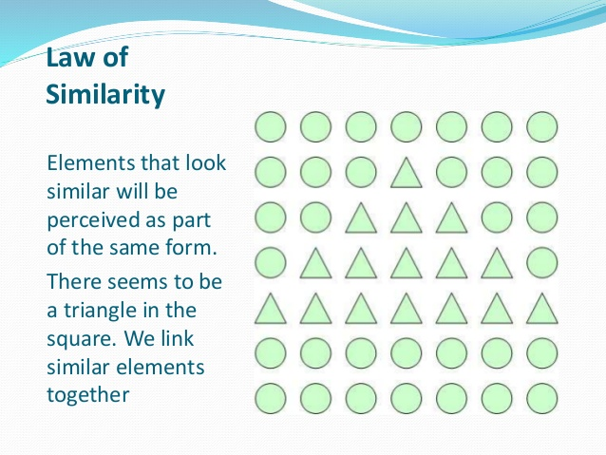
Chapter Two : laws of perception

Slide 21
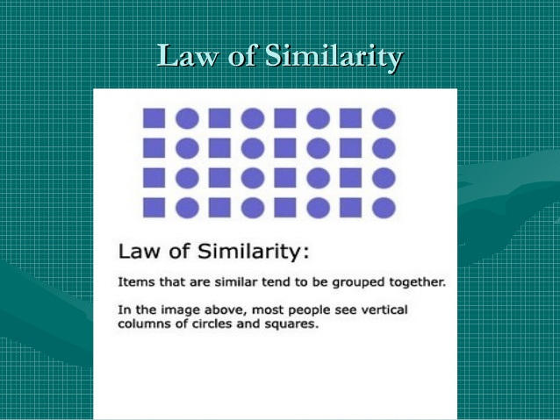
Chapter Two : laws of perception

Slide 22
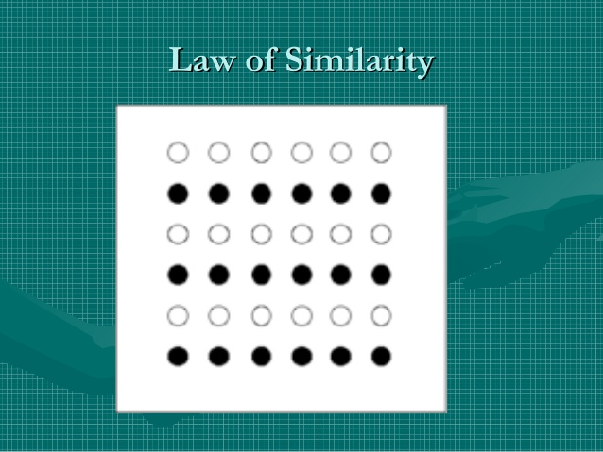
Chapter Two : laws of perception

Slide 23
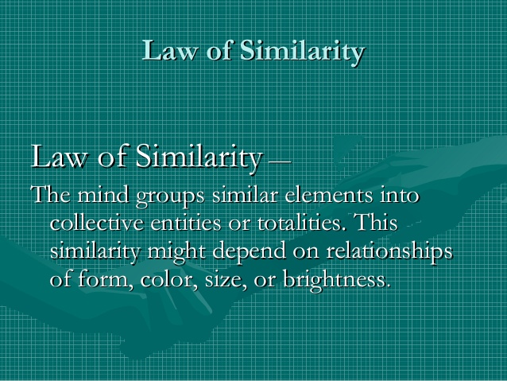
Chapter Two : laws of perception

Slide 24
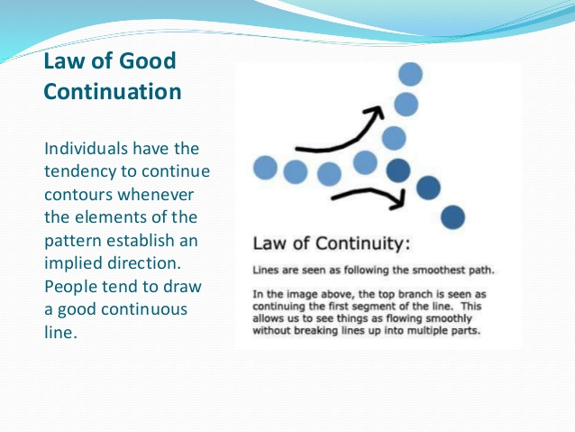
Chapter Two : laws of perception

Slide 25
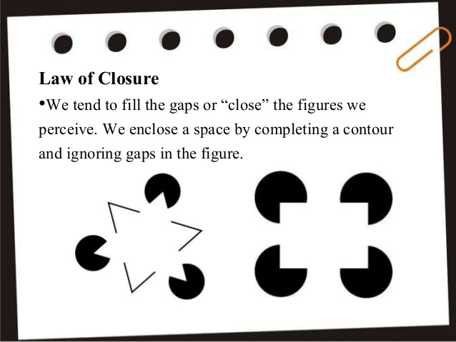
Chapter Two : laws of perception

Slide 26
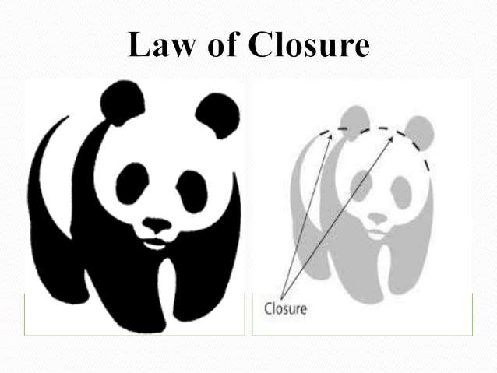
Chapter Two : laws of perception
Our mind has the tendency to fill the gapes to get complete meaning

Slide 27
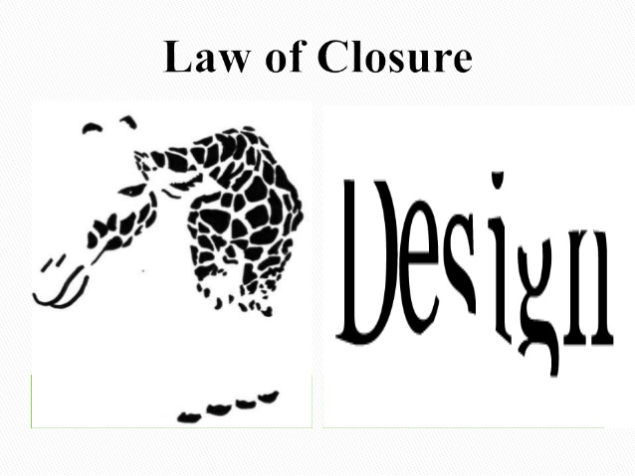
Chapter Two : laws of perception
Our mind has the tendency to fill the gapes to get complete meaning

Slide 28
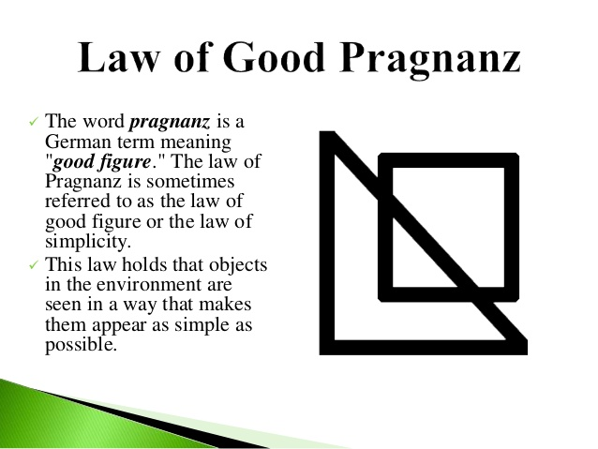
Chapter Two : laws of perception

Slide 29
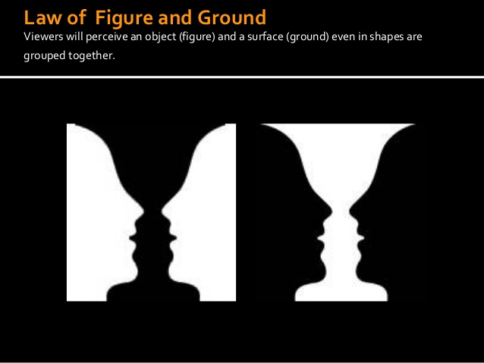
Chapter Two :Gestalt psychology and Perceptions

Slide 30

Chapter Two :Gestalt psychology and Perceptions

Slide 31
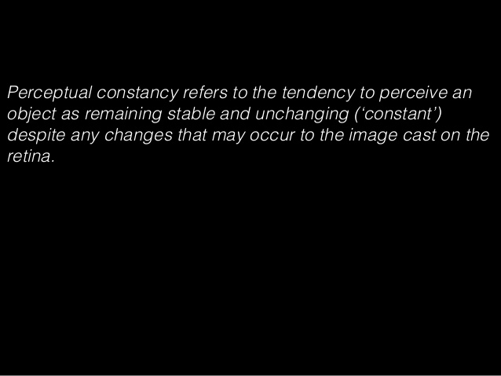
Chapter Two : perceptual constancy

Slide 32
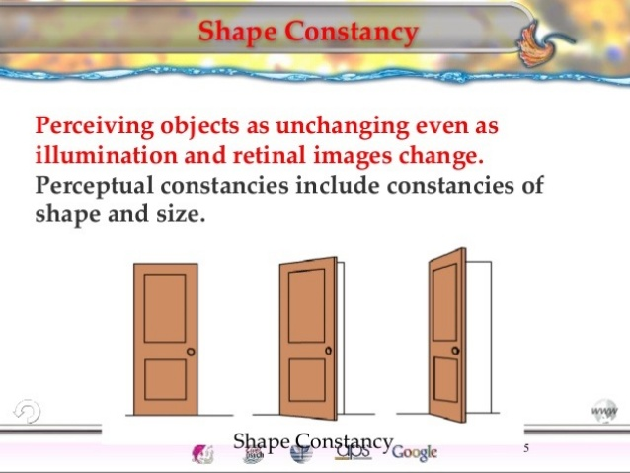
Chapter Two : perceptual constancy

Slide 33
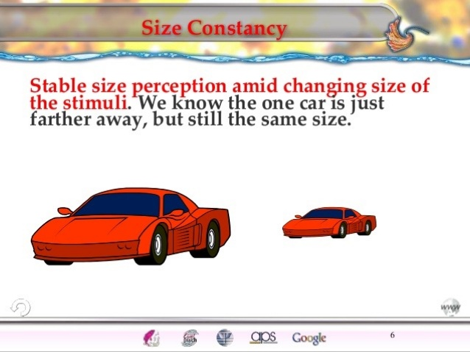
Chapter Two : perceptual constancy

Slide 34
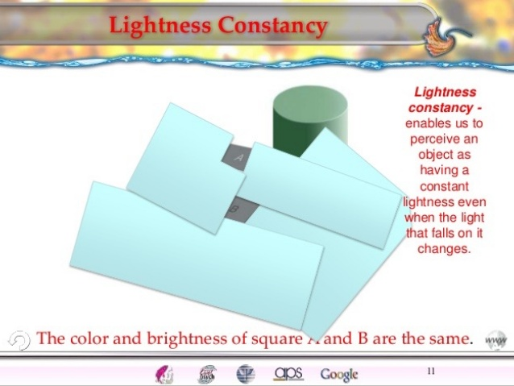
Chapter Two : perceptual constancy

Slide 35
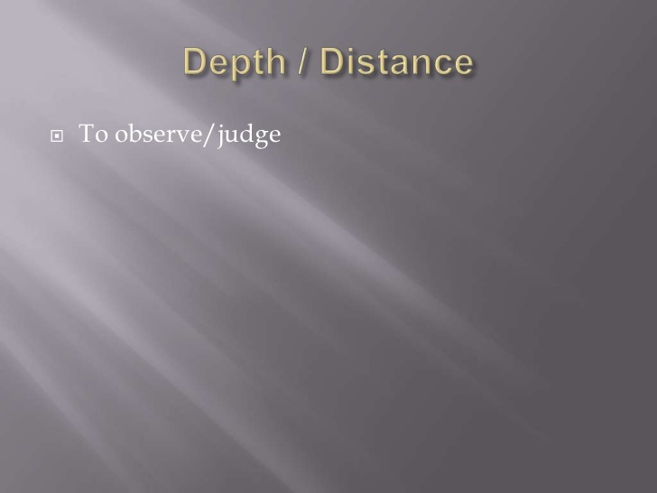
Chapter Two: depth and Distance perception

Slide 36
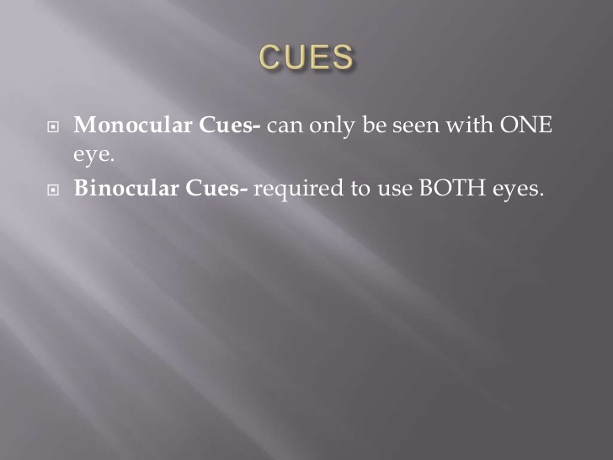
Chapter Two: depth and Distance perception
Ddddd
Depth perception depends on the use binocular cues and monocular cues there are two kinds of binocular cues: retinal disparity and convergence. The two kinds of binocular cues require the interaction of both eyes. Retinal disparity is, the degree of difference between the image of an object that are focused on the two retinas. The closer the object, the greater is the retinal disparity
To demonstrate retinal disparity for yourself, point a forefinger vertically between
your eyes.

Slide 37
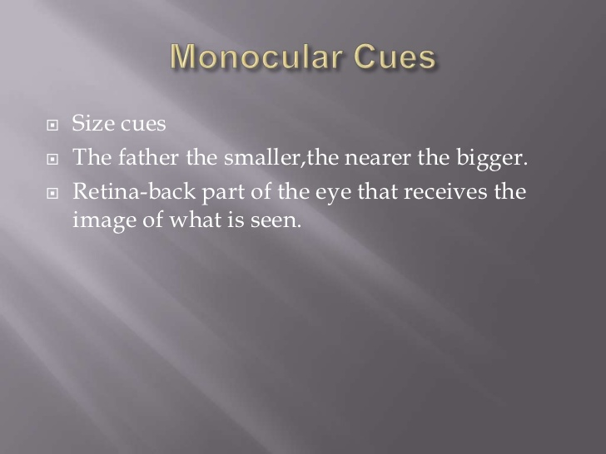
Chapter Two: depth and Distance perception

Slide 38
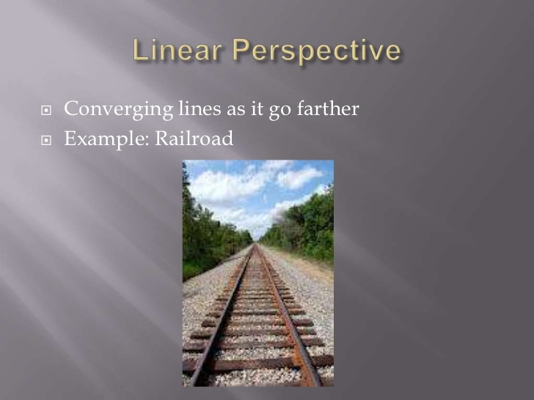
Chapter Two: depth and Distance perception

Slide 39
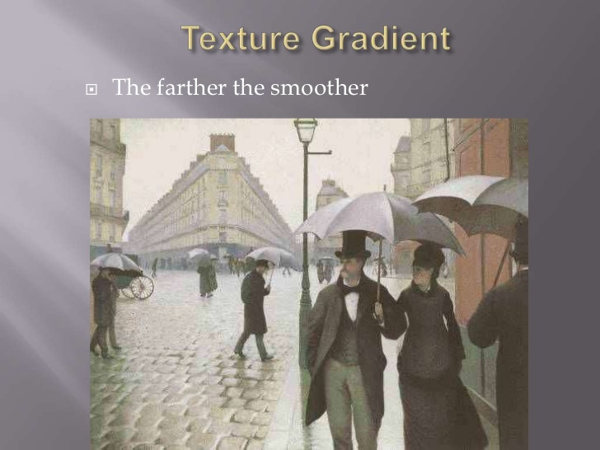
Chapter Two: depth and Distance perception

Slide 40
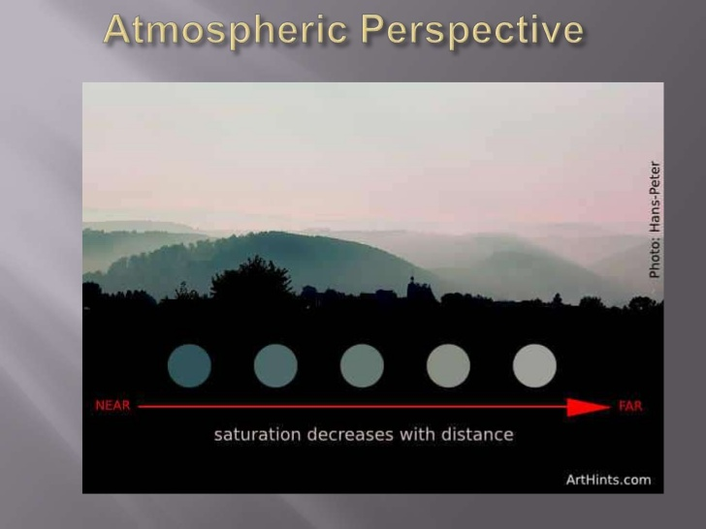
Chapter Two: depth and Distance perception

Slide 41
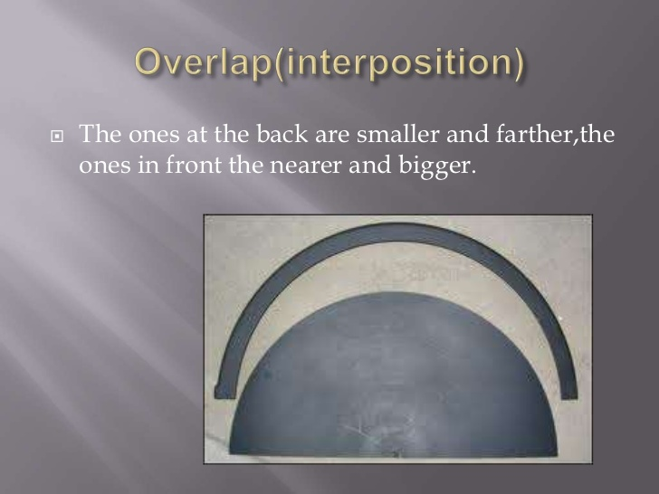
Chapter Two: depth and Distance perception

Slide 42
Chapter Three : Learning
Learning
Definition of learning
Relatively permanent change in behavior as result of experiences : training or practice

Slide 43
Chapter Three : Learning
The above definition emphasizes four attributes of learning:
Learning is a change in behavior
This change in behavior is relatively permanent
It does not include change due to illness, fatigue, maturation and use of intoxicant.
This permanent change in behavior is not because of biological factors (like hormonal
changes) that bring permanent changes in behavior; but because of experience, or practice
The learning is not directly observable but manifests in the activities of the individual.

Slide 44
Chapter Three : Learning
Characteristics of learning
1. Learning is continuous modification of behavior throughout life
Learning is pervasive, it reaches into all aspects of human life.
Learning involves the whole person, socially, emotionally & intellectually
Learning is often a change in the organization of experiences.
Learning is responsive to incentives
Learning is an active process
Learning is purposeful
Learning depends on maturation, motivation and practice.
Learning is multifaceted

Slide 45
Chapter Three : Learning
Principles of learning
Individuals learn best when they are physically, mentally, and emotionally y ready to learn.
Students learn best and retain information longer when they have meaningful practice and exercise
Learning is strengthened when accompanied by a pleasant or satisfying feeling, and that
learning is weakened when associated with an unpleasant feeling.
Things learned first create a strong impression in the mind that is difficult to erase.

Slide 46
Chapter Three : Learning
…Principles of learning
Things most recently learned are best remembered.
The principle of intensity implies that a student will learn more from the real thing than from a substitute.
Individuals must have some abilities and skills that may help them to learn.
Things freely learned are best learned - the greater the freedom enjoyed by individuals, the
higher the intellectual and moral advancement.

Slide 47
Chapter Three : Learning
Factors affecting learning
1.Motivation: When the motives of learning are high, the learner becomes enthusiastic.
2. Maturation: Neuro-muscular coordination is important for learning a given task.
Health condition of the learner: The learner should be in a good health status to learn.

Slide 48
Chapter Three : Learning
…Factors affecting learning
Psychological wellbeing of the learner: individual‘s psychological states like worries, fears, feelings of loneliness and inferiority hinders learning. Whereas self-respect, self-reliance, and self-confidence are necessary for effective learning.
Good working conditions – absence or presence of fresh air, light, comfortable surroundings, moderate temperature, absence of distractions like noise and learning aids determine learning effectiveness.

Slide 49
Chapter Three : Learning
Factors affecting learning
6. Background experiences: having background experiences affect effectiveness of learning. All related facts and understandings from a previously learned course should be brought to new learning.
7. Length of the working period: Learning periods should neither be too short nor too long. Long learning time sets fatigue and reduces effectiveness in learning. Short learning time doesn‘t allow adequate practice needed to master a learning task.
8. Massed and distributed learning: Learning that spreads across time with reasonable time gaps brings better results compared with crammed learning that occurs at once or within short span of time

Slide 50
Chapter Three : Learning theories
Classical conditioning theory –behavioral
Operant conditioning – behavioral
Social Learning Theory (observational learning) theory
Cognitive learning may take two forms:
1. Latent learning
2. Insight learning (gestalt learning or perceptual learning)

Slide 51
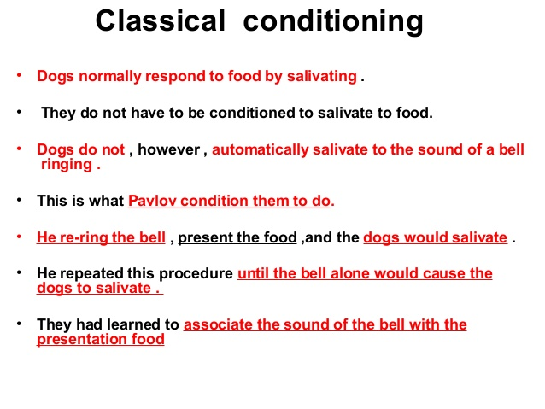
Chapter Two: Learning theories

Slide 52
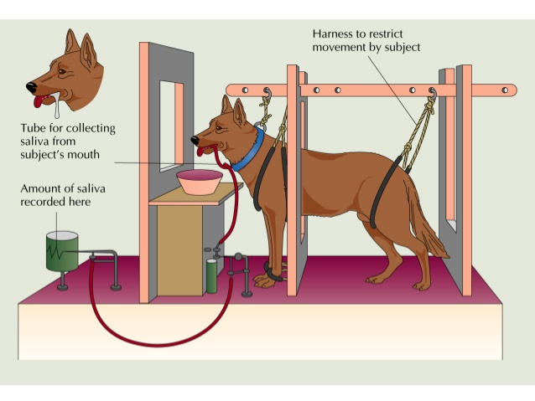
Classical conditioning; experiments

Slide 53
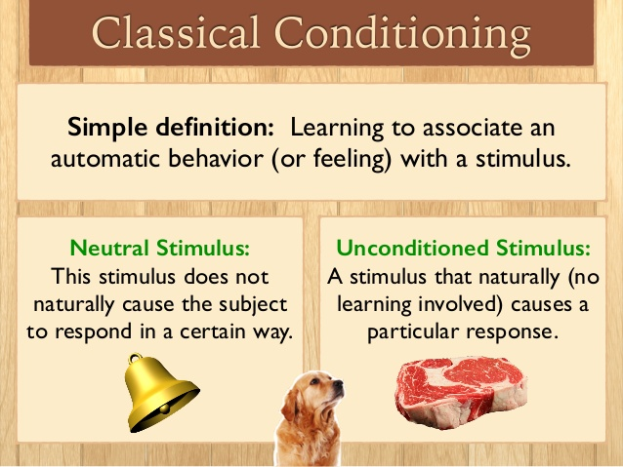
…Learning through association

Slide 54
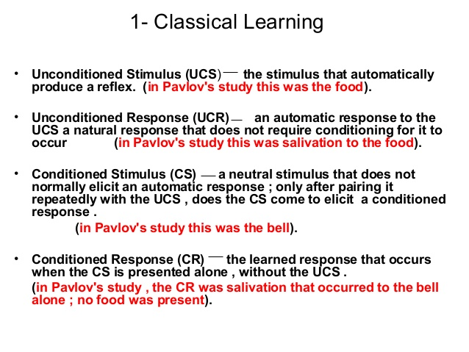
…..Basic elements

Slide 55
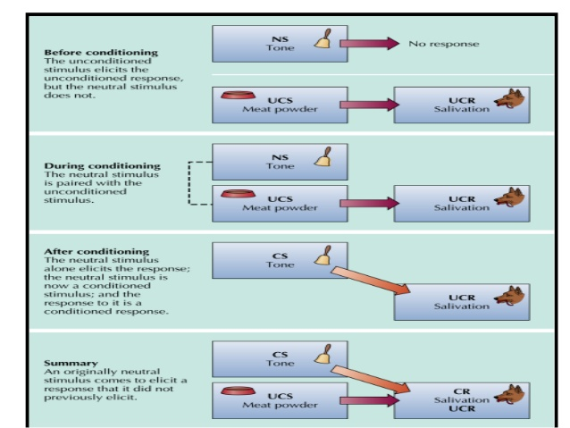
Stages of CC…
Notes:
Stages of classical conditioning

Slide 56
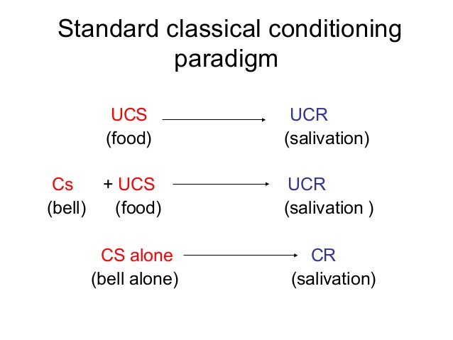
Stimulus –response association

Slide 57
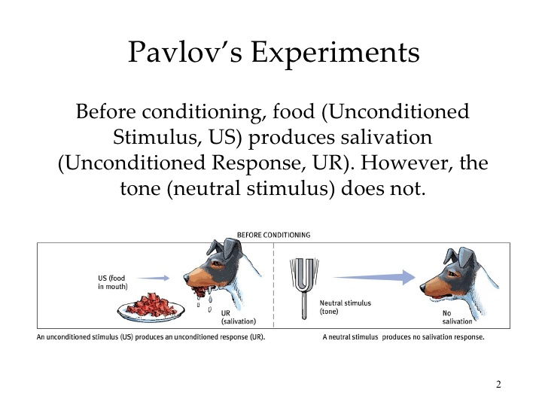

Slide 58
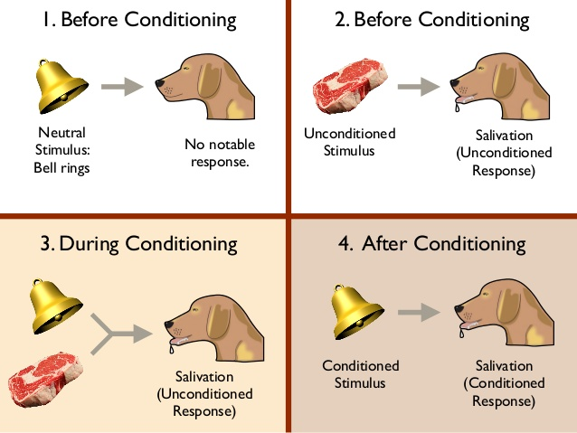

Slide 59
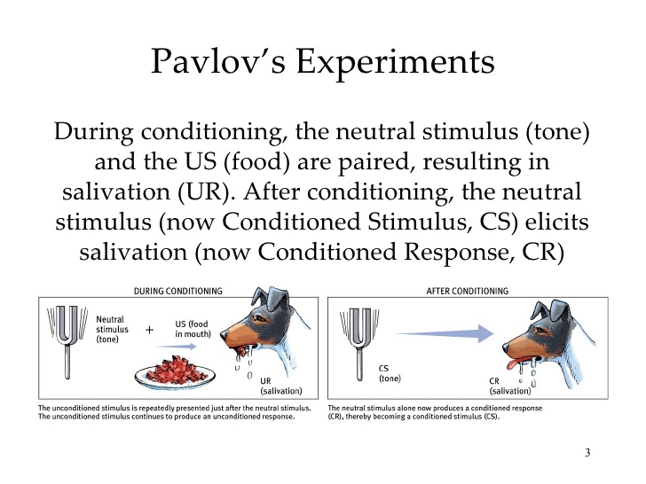

Slide 60
Chapter Three : Learning theories
Principles of Classical Condition
The basic principles of classical conditioning include the role of stimulus generalization, stimulus discriminations, extinction and spontaneous recovery
Stimulus generalization and stimulus discrimination
Stimulus generalization is a process in which, after a stimulus has been conditioned to produce a particular response, stimuli that are similar to the original stimulus begin to produce the same responses. For example, a dog conditioned to salivate to a dinner bell (CS) might also salivate to a door bell, a telephone bell

Slide 61
Chapter Three : Learning theories
Principles of Classical Condition
Stimulus discrimination- is the process of distinguishing two similar stimuli; the ability to differentiate between stimuli.
Example, the dog salivates only in response to the dinner bell instead of the doorbell or the telephone bell

Slide 62
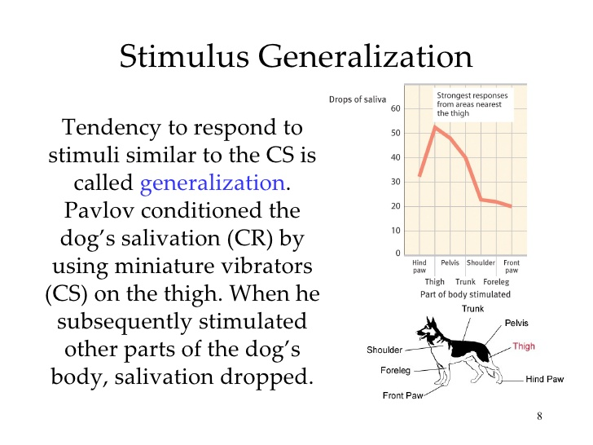

Slide 63


Slide 64
Chapter Three : Learning theories
Principles of Classical Condition
B. Extinction and spontaneous recovery

Slide 65

Notes:
Principles of classical conditioning

Slide 66


Slide 67

2. Operant conditioning

Slide 68
2. Operant conditioning
In Skinner‘s analysis, a response (operant) can lead to three types of consequences: I. a neutral consequence II. a reinforcement and III. A punishment.
A neutral Consequence that does not alter the response
A reinforcement
A Punishment

Slide 69


Operant Conditioning
A type of learning in which behavior is strengthened if followed by reinforcement or diminished if followed by punishment.

Slide 70

Cont…

Slide 71

B.F. Skinner
expanded on Thorndike’s work
shaping (reward approximations of the desired behavior)

Slide 72


Slide 73
2. Operant conditioning
There are two basic types of reinforcers or reinforcing stimuli:
Primary reinforcers- Food, water, light, stroking of the skin, and a comfortable air temperature are naturally reinforcing because they satisfy biological needs.
Has the ability to strengthen a behavior without prior learning.
Secondary Reinforcers- Behaviors can be controlled by secondary reinforcers. They reinforce behavior because of their prior association with primary reinforcing stimuli.
Money, praise, applause, good grades, awards, and gold stars are common secondary reinforcers.

Slide 74
2. Operant conditioning
Both primary and secondary reinforcers can be positive or negative.
Positive reinforcement is the process whereby presentation of a stimulus makes behavior more likely to occur again.
Negative reinforcement is the process whereby termination of an aversive stimulus makes behavior more likely to occur.
The basic principle of negative reinforcement is that eliminating something aversive can itself be a reinforcer or a reward.
Two types of negative reinforcement

Slide 75


Slide 76
2. Operant conditioning
Schedules of reinforcement- When a response is first acquired, learning is usually most rapid if the response is reinforced each time it occurs. This procedure is called continuous reinforcement. However, once a response has become reliable, it will be more resistant to extinction if it is rewarded on an intermittent (partial) schedule of reinforcement, which involves reinforcing only some responses, not all of them.
There are four types of intermittent schedules.

Slide 77
2. Operant conditioning
Fixed-ratio schedules- occurs after a fixed number of responses. It produces high rate of responding.
Employers often use fixed ratio schedules to increase productivity. An interesting feature of a fixed ratio schedule is that performance sometimes drops off just after reinforcement.
2.Variable-Ratio Schedule- occurs after some average number of responses but the number varies from reinforcement to reinforcement.
A variable ratio schedule of produces extremely high steady rates of responding. The responses are more resistant to extinction than a fixed ratio schedule is used.

Slide 78
2. Operant conditioning
3. Fixed- Interval Schedule- occurs only if a fixed amount of time has passed since the previous reinforcer.
4. Variable- Interval Schedule- occurs only if a variable amount of time has passed since the previous reinforcer.
A basic principle of operant conditioning is that if you want a response to persist after it has been learned, you should reinforce it intermittently, not continuously

Slide 79
2. Operant conditioning
Punishment- is a stimulus that weakens the response or makes it less likely to occur again. Punishers can be any aversive (unpleasant) stimuli that weaken responses or make them unlikely to reoccur . Like reinforcers, punishers can also be primary or secondary.
Pain and extreme heat or cold are inherently punishing and are therefore known as primary punishers.
Criticism, demerits, catcalls, scolding, fines, and bad grades are common secondary punishers.

Slide 80
2. Operant conditioning
The positive-negative distinction can also be applied to punishment
Something unpleasant may occur following some behavior (positive punishment), or
something pleasant may be removed following the behavior (negative punishment).

Slide 81
2. Operant conditioning
The Pros and Cons of Punishment
Immediacy – When punishment follows immediately after the behavior to be punished.
Consistency- when punishment is inconsistent the behavior being punished is intermittently reinforced and therefore becomes resistant to extinction.
Intensity- In general terms severe punishments are more effective than mild ones.
However, there are studies that indicate that even less intense punishments are effective provided that they are applied immediately and consistently.

Slide 82
2. Operant conditioning
However, when punishment fails
People often administer punishment inappropriately or mindlessly
The recipient of punishment often responds with anxiety, fear or rage
The effectiveness of punishment is often temporary, depending heavily on the presence of the punishing person or circumstances
Most behavior is hard to punish immediately
5. Punishment conveys little information. An action intended to punish may instead be reinforcing because it brings attention

Slide 83
2. Operant conditioning
Shaping
For a response to be reinforced, it must first occur. But, suppose you want to train a child to use a knife and a fork properly. Such behaviors, and most others in everyday life, have almost no probability of appearing spontaneously.
The operant solution for this is shaping.
Shaping is an operant conditioning procedure in which successive approximations of a desired response are reinforced. In shaping you start by reinforcing a tendency in the right direction. Then you gradually require responses that are more and more similar to the final desired response. The responses that you reinforce on the way to the final one are called successive approximations.

Slide 84
2. Operant conditioning
Applications of operant conditioning ( reading assignment)
Conditioning study behavior
Conditioning and classroom behavior
Managing Problem Behavior
Dealing with anxieties through conditioning
Conditioning group behavior
Conditioning and Cognitive Processes
Shaping Complex Behavior

Slide 85
Chapter 3: learning
Social Learning Theory (observational learning) theory
According to Bandura, a major part of human learning consists of observational learning, which is learning by watching the behavior of another person, or the model.
Because of its reliance on observation of others, a social phenomenon; the perspective taken by Bandura is often referred to as a social cognitive approach to learning (Bandura, 1999, 2004).

Slide 86


Slide 87
Chapter 3: learning
Bandura identifies three forms of reinforcement that can encourage observational learning.
direct reinforcement
vicarious reinforcement – not direct or indirect
self-reinforcement, or controlling

Slide 88
Chapter 3: learning
4 conditions of the of the modeling process
Attention
2. Retention- remembering the observed behavior
3. Motor reproduction- demonstrated
4. Motivation – approval

Slide 89
Chapter 3: learning
Classroom implications ( reading assignment )
Students often learn a great deal simply by observing other people
2. Describing the consequences of behavior can effectively increase the appropriate behaviors and decrease inappropriate ones
3. Modeling provides an alternative to shaping for teaching new behaviors

Slide 90
Chapter 3: learning
…Classroom implications ( reading assignment )
4. Teachers and parents must model appropriate behaviors and take care that they do not model inappropriate behaviors.
5. Teachers should expose students to a variety of other models
6. Students must believe that they are capable of accomplishing school tasks.

Slide 91
Chapter 3: learning
… Classroom implications (reading assignment)
7.Teachers should help students set realistic expectations for their academic accomplishments

Slide 92
Chapter 3: learning
Cognitive Learning Theory
1. Latent Learning
Latent means hidden and thus latent learning is learning that occurs but is not evident in behavior until later, when conditions for its appearance are favorable. It is said to occur without reinforcement of particular responses and seems to involve changes in the way information is processed
2. Insight Learning
- It is a cognitive process whereby we reorganize our perception of a problem. It doesn‘t depend on conditioning of particular behaviors for its occurrence. Sometimes, for example, people even wake up from sleep with a solution to a problem that they had not been able to solve during the day.

Slide 93
CHAPTER FOUR MEMORY AND FORGETTING

